Slide 1
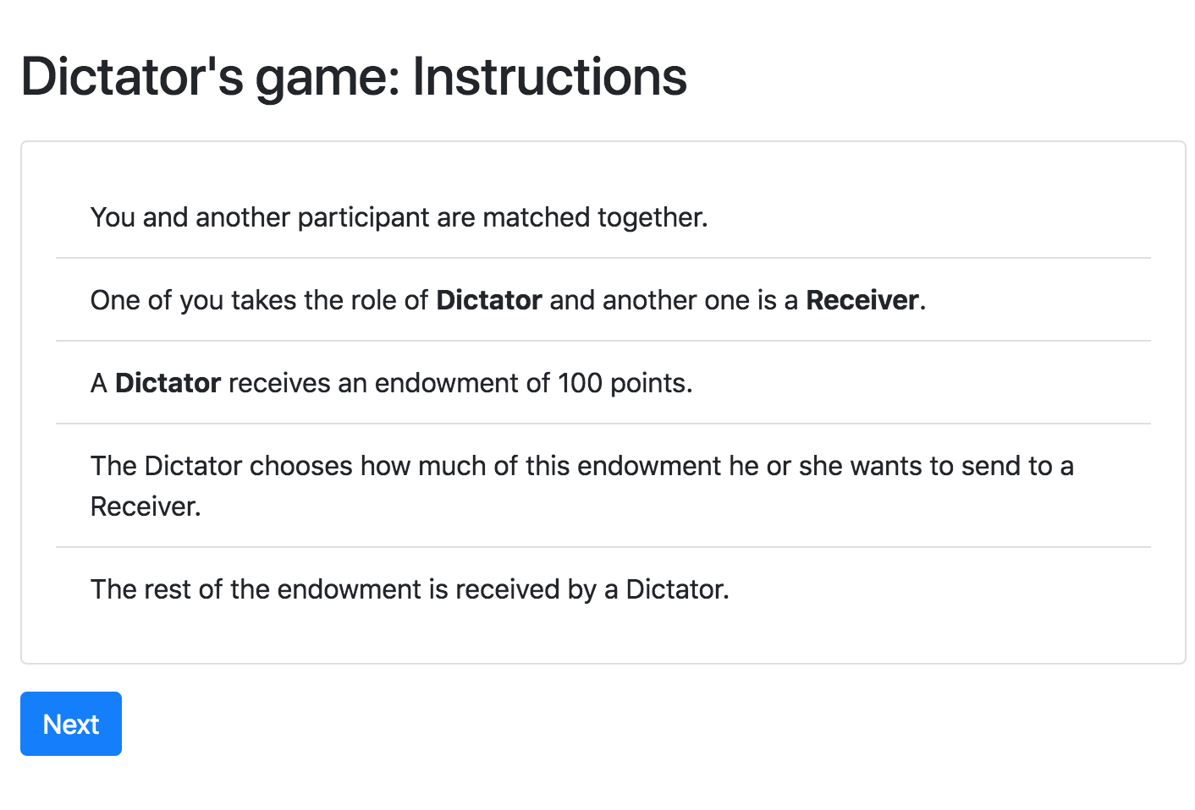
Dictator game – screen 1

Slide 2
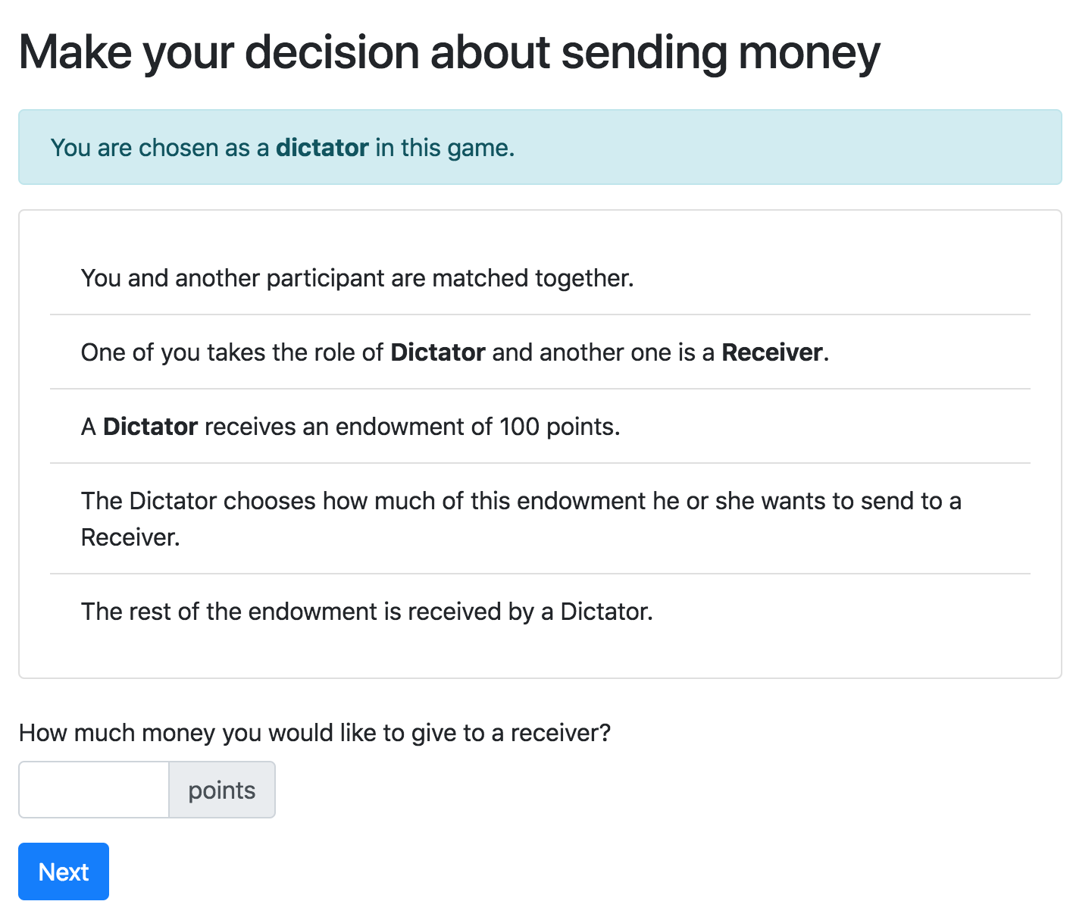
Dictator game – screen 2

Slide 3
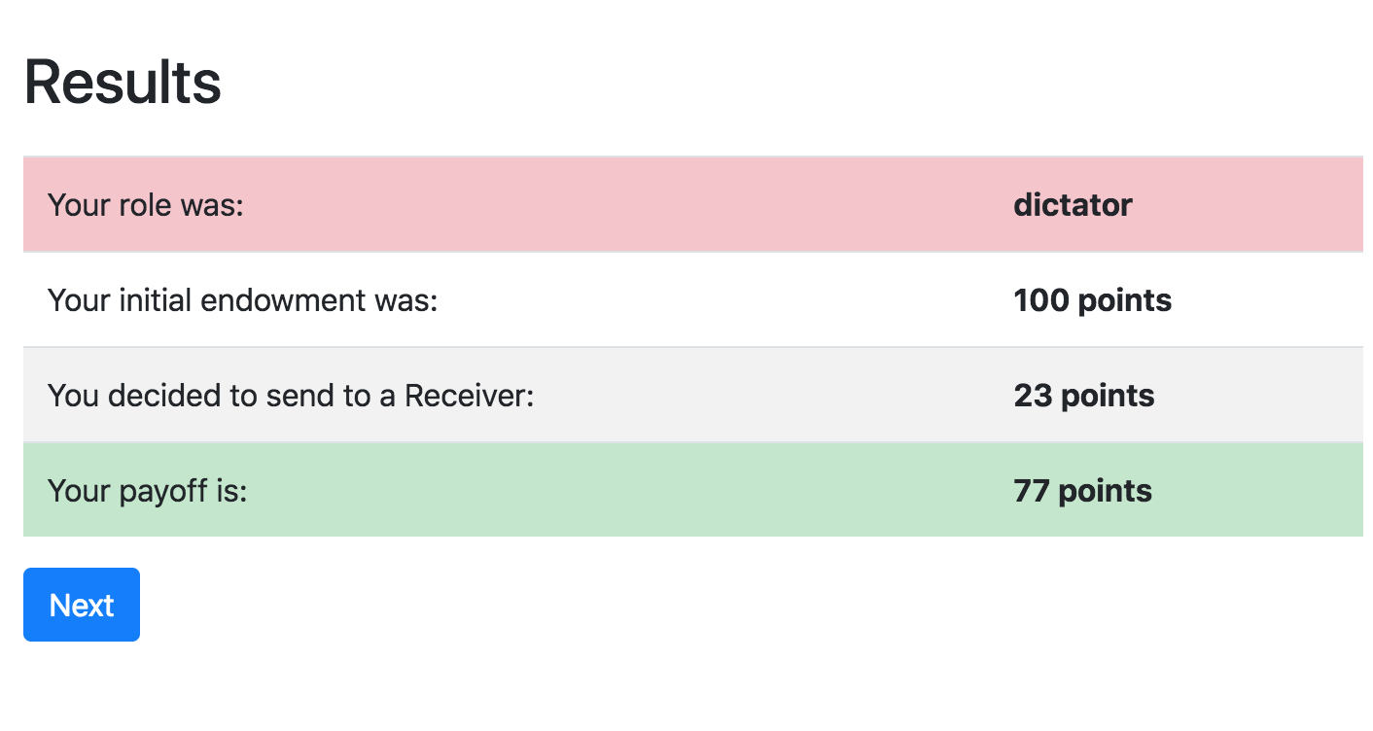
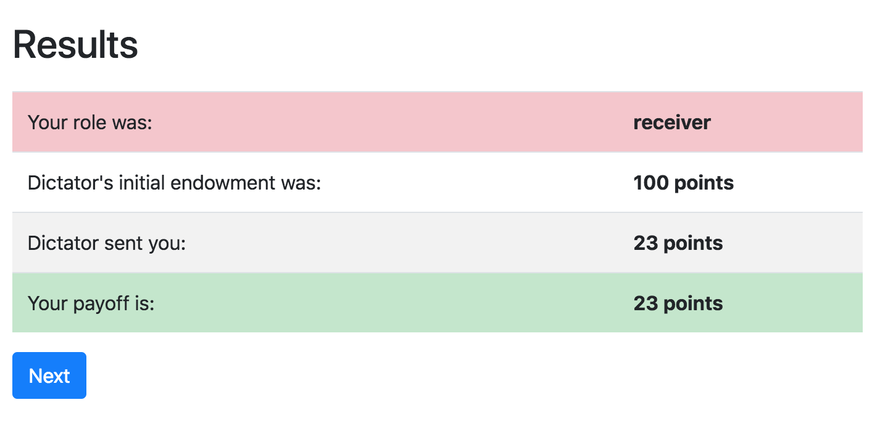
Dictator game – screen 3
DICTATOR:
RECEIVER:

Slide 4
Dictator game - blueprint
2 players
Two roles (Dictator and Receiver)
No necessity for Dictator to wait for the Receiver.
1 round
Roles should be assigned before the game starts
Roles are assigned; Dictator makes the decision; Receiver is informed
Payoffs: after Dictator makes the decision
Receiver needs Dictator’s decision

Slide 5
Dictator game - roles
class Player(BasePlayer): def role(self): if self.id_in_group==1: return 'dictator' else: return 'receiver'
role() is a method of a Player’s model
we can use id of a player within a group to assign roles
…. or any other logic

Slide 6
Dictator game – conditional view
class Decision(Page): form_model=group' form_fields = ['dg_decision'] def is_displayed(self): return self.player.role() == 'dictator'
is_displayed is a method built-in in a Page
by default it is shown to all players
if under certain condition it returns False, it is skipped

Slide 7
Dictator game – waitpage
WaitPage is a special class of pages
by default all members of a group wait until everyone reaches this stage
after that they proceed further along page_sequence
when players reach the waitpage, the after_all_players_arrive is executed
it can be skipped with is_displayed method (as normal Page)

Slide 8
Templates: loops, conditions
You can use conditions and loops in templates:
{% if player.age < 30 %}
hi, dude!
{% else %}
Dear Mr. Player,
{% endif %}

Slide 9
Other players info
You can obtain information about other players, using their ids in group or roles:
self.group.get_player_by_role('ROLE_NAME')
self.group.get_player_by_id('ID')

Slide 10
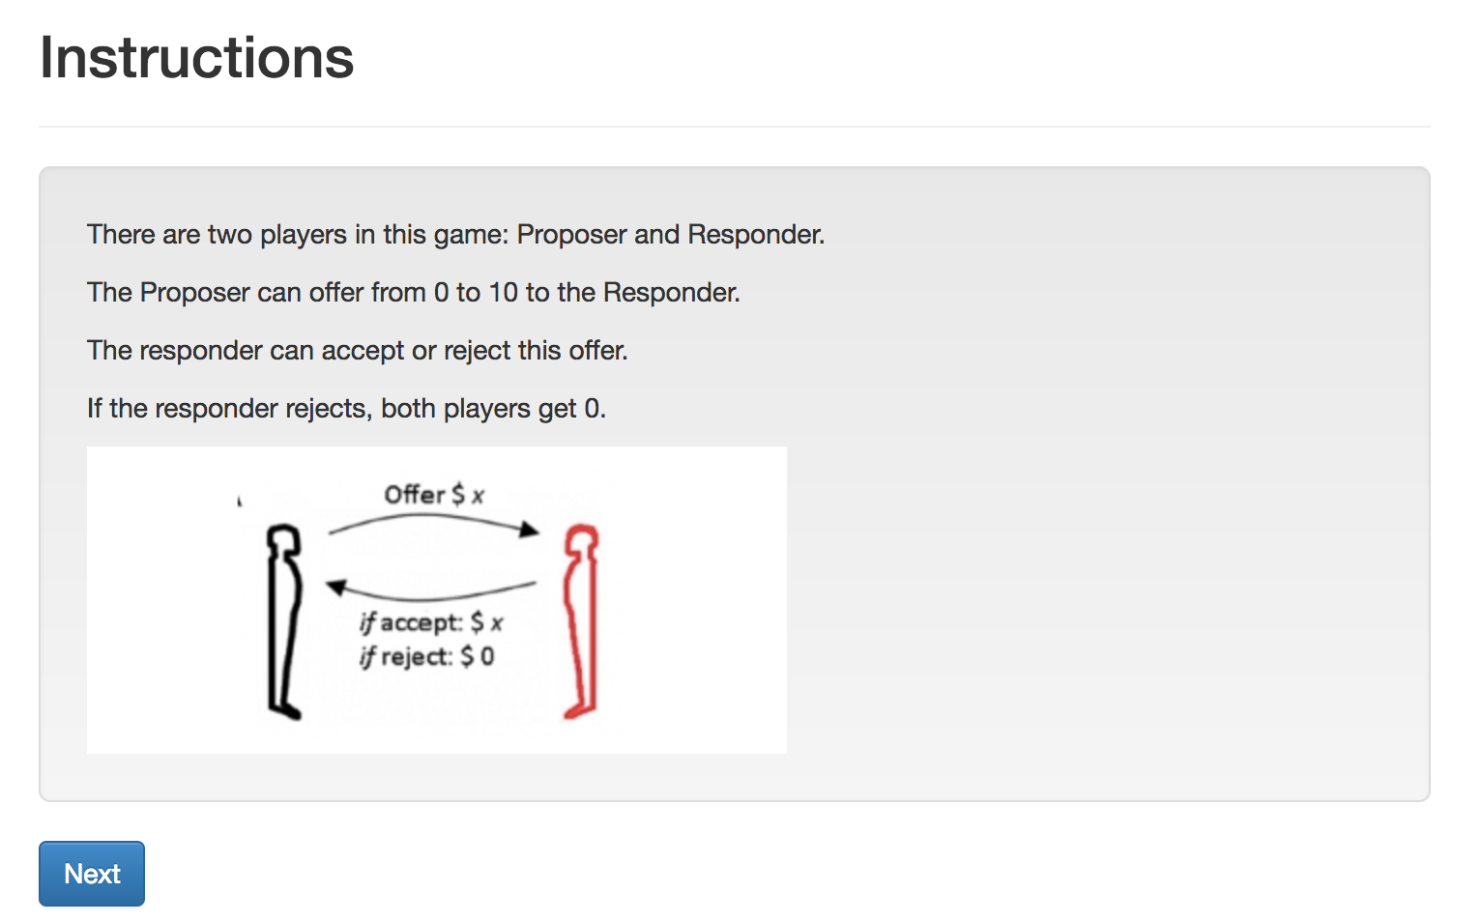
Ultimatum. Screen 1. Intro

Slide 11
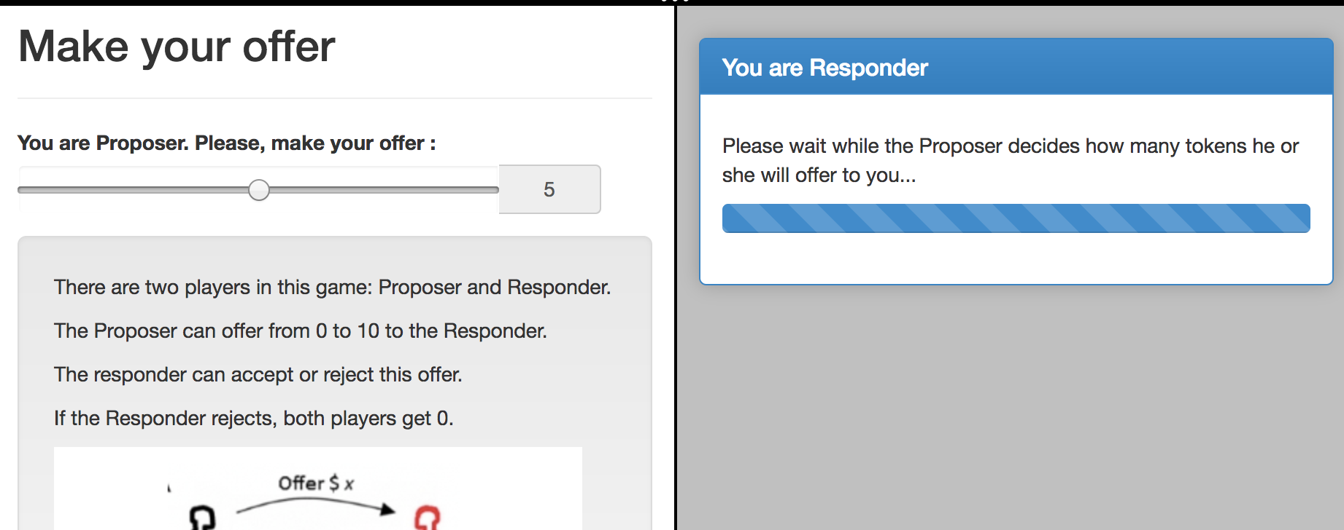
Ultimatum. Screen 2. Offer

Slide 12
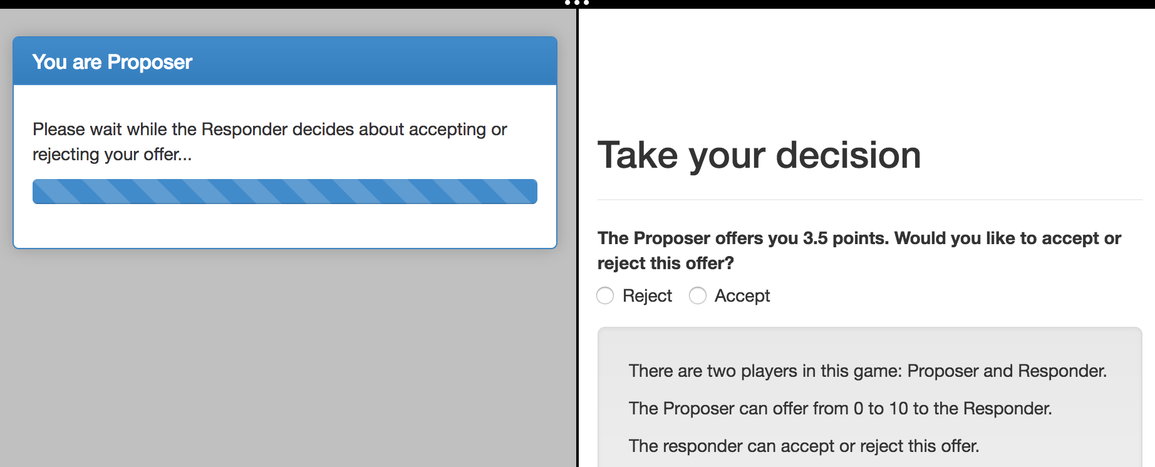
Ultimatum. Screen 3. Accept/Reject

Slide 13
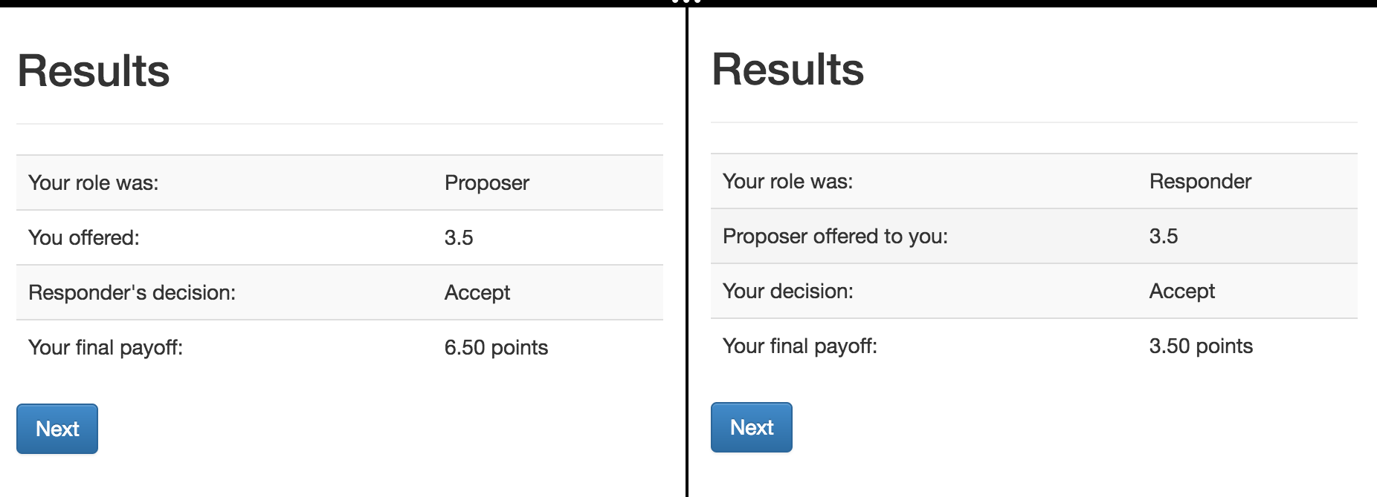
Ultimatum. Screen 4. Results

Slide 14
Ultimatum: some preliminary prep
Let’s run ‘otree startapp ultimatum’
and copy from our guess app: intro, decision, instructions
… rename in intro and decision the % include %:
TO: {% include 'ultimatum/instructions.html' %}
make a copy of decision.html
rename files to: Offer.html, Accept.html

Slide 15
Ultimatum: multi-player game
In models.py: Constants: players_per_group = 2
NB: when there is only one player then players_per_group = None, not 1!
In Player we define function that returns the role
class Player(BasePlayer):
def role(self):
if self.id_in_group == 1:
return 'Proposer'
if self.id_in_group == 2:
return 'Responder'

Slide 16
Ultimatum: planning I
The workflow:
1. Introduction
2. Player 1 decides about an offer, Player 2 waits
3. Player 2 decides whether accepting or not. Player 1 waits.
4. Both see the results.
We need 6 pages. For (2) and (3) a set of (Page, WaitPage)
Page in (2) will be shown only to Proposer
Page in (3) will be shown only to Responder

Slide 17
Ultimatum: models.py
Creating new fields in models.py:
We need fields in group, because these fields are the same for both players.
Notes:
class Group(BaseGroup):
offer = models.FloatField(min=0,
max=Constants.endowment,
widget=\
widgets.SliderInput(attrs={'step': '0.1'}),
verbose_name="You are Proposer. Please, \
make your offer")
accept = models.BooleanField(choices=[(False,'Reject'),(True,'Accept')],
widget=widgets.RadioSelectHorizontal())
def set_payoffs(self):
proposer = self.get_player_by_role('Proposer')
responder = self.get_player_by_role('Responder')
proposer.payoff = (Constants.endowment - self.offer) * self.accept
responder.payoff = self.offer * self.accept

Slide 18
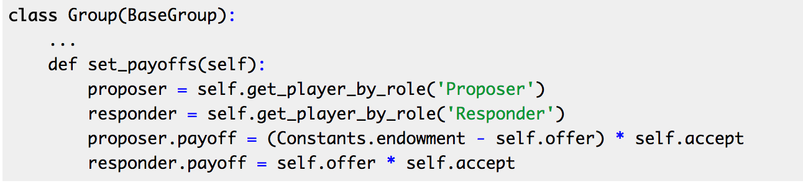
Ultimatum: models.py
Defining the function that will be able to set the payoffs of the players depending on their role in a group:
Notes:
class Group(BaseGroup):
offer = models.FloatField(min=0,
max=Constants.endowment,
widget=\
widgets.SliderInput(attrs={'step': '0.1'}),
verbose_name="You are Proposer. Please, \
make your offer")
accept = models.BooleanField(choices=[(False,'Reject'),(True,'Accept')],
widget=widgets.RadioSelectHorizontal())
def set_payoffs(self):
proposer = self.get_player_by_role('Proposer')
responder = self.get_player_by_role('Responder')
proposer.payoff = (Constants.endowment - self.offer) * self.accept
responder.payoff = self.offer * self.accept

Slide 19
Static files: how insert an image?
Create folder in an app:
…/static/ultimatum
Put your image there
insert in in the beginning of your instructions.html:
{% load staticfiles %}
and in the text:
<img src="{% static "ultimatum/ultimatum.png" %}"/>
Notes:
from otree.api import Currency as c, currency_range
from . import models
from ._builtin import Page, WaitPage
from .models import Constants
class Intro(Page):
pass
class Offer(Page):
form_model = models.Group
form_fields = ['offer']
def is_displayed(self):
return self.player.role() == 'Proposer'
def vars_for_template(self):
...
class OfferWaitPage(WaitPage):
title_text = "You are Responder"
body_text = "Please wait while the Proposer decides how many tokens he \
or she will offer to you..."
class Accept(Page):
form_model = models.Group
form_fields = ['accept']
def is_displayed(self):
return self.player.role() == 'Responder'
def vars_for_template(self):
return {'offer_text': "The Proposer offers you {} points. Would you like \
to accept or reject this offer?".format(self.group.offer)}
class ResultsWaitPage(WaitPage):
title_text = "You are Proposer"
body_text = "Please wait while the Responder decides about accepting \
or rejecting your offer..."
def after_all_players_arrive(self):
self.group.set_payoffs()
class Results(Page):
def vars_for_template(self):
return {'accept': 'Accept' if self.group.accept else 'Reject'}
page_sequence = [
Intro,
Offer,
OfferWaitPage,
Accept,
ResultsWaitPage,
Results
]

Slide 20
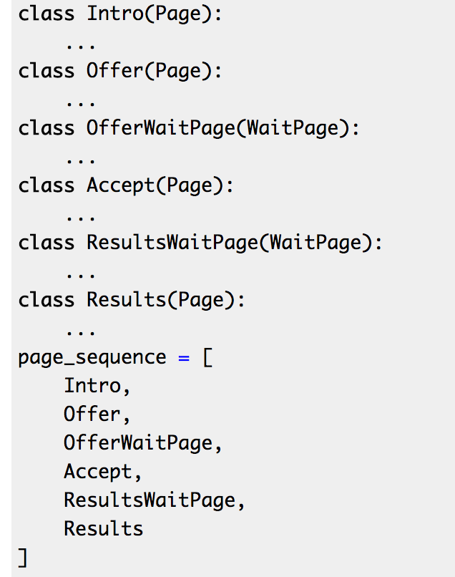
Ultimatum: pages.py
class Offer(Page):
form_model = models.Group
form_fields = ['offer']
def is_displayed(self):
return self.player.role() == 'Proposer'
class OfferWaitPage(WaitPage):
title_text = "You are Responder"
body_text = "Please wait while the Proposer decides how many tokens he \
or she will offer to you...”
def is_displayed(self):
return self.player.role() == 'Responder'
Notes:
from otree.api import Currency as c, currency_range
from . import models
from ._builtin import Page, WaitPage
from .models import Constants
class Intro(Page):
pass
class Offer(Page):
form_model = models.Group
form_fields = ['offer']
def is_displayed(self):
return self.player.role() == 'Proposer'
def vars_for_template(self):
...
class OfferWaitPage(WaitPage):
title_text = "You are Responder"
body_text = "Please wait while the Proposer decides how many tokens he \
or she will offer to you..."
class Accept(Page):
form_model = models.Group
form_fields = ['accept']
def is_displayed(self):
return self.player.role() == 'Responder'
def vars_for_template(self):
return {'offer_text': "The Proposer offers you {} points. Would you like \
to accept or reject this offer?".format(self.group.offer)}
class ResultsWaitPage(WaitPage):
title_text = "You are Proposer"
body_text = "Please wait while the Responder decides about accepting \
or rejecting your offer..."
def after_all_players_arrive(self):
self.group.set_payoffs()
class Results(Page):
def vars_for_template(self):
return {'accept': 'Accept' if self.group.accept else 'Reject'}
page_sequence = [
Intro,
Offer,
OfferWaitPage,
Accept,
ResultsWaitPage,
Results
]

Slide 21
Ultimatum: views.py
class Accept(Page):
form_model = models.Group
form_fields = ['accept']
def is_displayed(self):
return self.player.role() == 'Responder'
def vars_for_template(self):
return {'offer_text': "The Proposer offers you {} points. Would you like \
to accept or reject this offer?".format(self.group.offer)}
class ResultsWaitPage(WaitPage):
title_text = "You are Proposer"
body_text = "Please wait while the Responder decides about accepting \
or rejecting your offer..."
def after_all_players_arrive(self):
self.group.set_payoffs()
Notes:
from otree.api import Currency as c, currency_range
from . import models
from ._builtin import Page, WaitPage
from .models import Constants
class Intro(Page):
pass
class Offer(Page):
form_model = models.Group
form_fields = ['offer']
def is_displayed(self):
return self.player.role() == 'Proposer'
def vars_for_template(self):
...
class OfferWaitPage(WaitPage):
title_text = "You are Responder"
body_text = "Please wait while the Proposer decides how many tokens he \
or she will offer to you..."
class Accept(Page):
form_model = models.Group
form_fields = ['accept']
def is_displayed(self):
return self.player.role() == 'Responder'
def vars_for_template(self):
return {'offer_text': "The Proposer offers you {} points. Would you like \
to accept or reject this offer?".format(self.group.offer)}
class ResultsWaitPage(WaitPage):
title_text = "You are Proposer"
body_text = "Please wait while the Responder decides about accepting \
or rejecting your offer..."
def after_all_players_arrive(self):
self.group.set_payoffs()
class Results(Page):
def vars_for_template(self):
return {'accept': 'Accept' if self.group.accept else 'Reject'}
page_sequence = [
Intro,
Offer,
OfferWaitPage,
Accept,
ResultsWaitPage,
Results
]

Slide 22
Ultimatum: dynamic label in Accept
{% block content %}
{% formfield group.accept label=offer_text %}
{% include 'ultimatum/instructions.html' %}
{% next_button %}
{% endblock %}

Slide 23
Ultimatum. Results
<table class="table table-striped table-hover">
<tr>
<td>Your role was:</td>
<td>{{player.role}}</td>
</tr>
{% if player.role == "Proposer" %}
<tr>
<td>You offered:</td>
<td>{{group.offer}}</td>
</tr>
<tr>
<td>Responder's decision:</td>
<td>{{accept}}</td>
</tr>
{% else %}
<tr>
<td>Proposer offered to you:</td>
<td>{{group.offer}}</td>
</tr>
<tr>
<td>Your decision:</td>
<td>{{accept}}</td>
</tr>
{% endif %}
<tr>
<td>Your final payoff:</td>
<td>{{player.payoff}}</td>
</tr>
</table>
Notes:
{% extends "global/Page.html" %}
{% load staticfiles otree_tags %}
{% block title %}
Results
{% endblock %}
{% block content %}
<table class="table table-striped table-hover">
<tr>
<td>Your role was:</td>
<td>{{player.role}}</td>
</tr>
{% if player.role == "Proposer" %}
<tr>
<td>You offered:</td>
<td>{{group.offer}}</td>
</tr>
<tr>
<td>Responder's decision:</td>
<td>{{accept}}</td>
</tr>
{% else %}
<tr>
<td>Proposer offered to you:</td>
<td>{{group.offer}}</td>
</tr>
<tr>
<td>Your decision:</td>
<td>{{accept}}</td>
</tr>
{% endif %}
<tr>
<td>Your final payoff:</td>
<td>{{player.payoff}}</td>
</tr>
</table>
{% next_button %}
{% endblock %}

Slide 24
Ultimatum. Results
<table class="table table-striped table-hover">
<tr>
<td>Your role was:</td>
<td>{{player.role}}</td>
</tr>
{% if player.role == "Proposer" %}
<tr>
<td>You offered:</td>
<td>{{group.offer}}</td>
</tr>
<tr>
<td>Responder's decision:</td>
<td>{{accept}}</td>
</tr>
{% else %}
<tr>
<td>Proposer offered to you:</td>
<td>{{group.offer}}</td>
</tr>
<tr>
<td>Your decision:</td>
<td>{{accept}}</td>
</tr>
{% endif %}
<tr>
<td>Your final payoff:</td>
<td>{{player.payoff}}</td>
</tr>
</table>
class Results(Page):
def vars_for_template(self):
return {'accept': 'Accept' if self.group.accept else 'Reject'}
in settings.py:
POINTS_DECIMAL_PLACES = 2
Notes:
{% extends "global/Page.html" %}
{% load staticfiles otree_tags %}
{% block title %}
Results
{% endblock %}
{% block content %}
<table class="table table-striped table-hover">
<tr>
<td>Your role was:</td>
<td>{{player.role}}</td>
</tr>
{% if player.role == "Proposer" %}
<tr>
<td>You offered:</td>
<td>{{group.offer}}</td>
</tr>
<tr>
<td>Responder's decision:</td>
<td>{{accept}}</td>
</tr>
{% else %}
<tr>
<td>Proposer offered to you:</td>
<td>{{group.offer}}</td>
</tr>
<tr>
<td>Your decision:</td>
<td>{{accept}}</td>
</tr>
{% endif %}
<tr>
<td>Your final payoff:</td>
<td>{{player.payoff}}</td>
</tr>
</table>
{% next_button %}
{% endblock %}

